Slide 1
Graph Visualization
Ng Yen Kaow

Slide 2
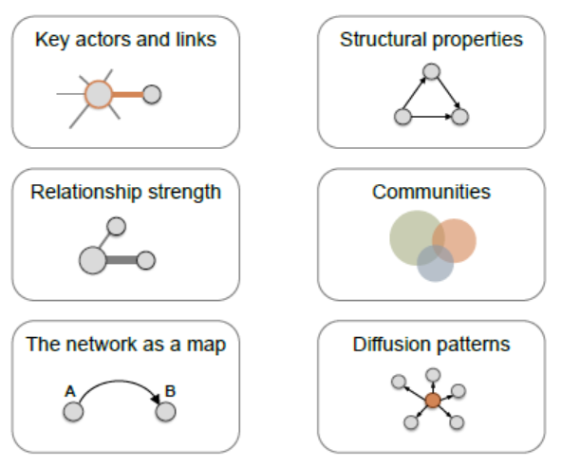
Network visualization
From “Network Visualization with R” (kateto.net/polnet2015)
  The goals of visualization are

Slide 3
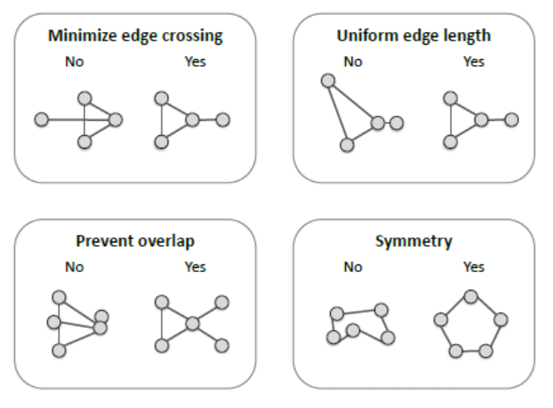
Network visualization
From “Network Visualization with R” (kateto.net/polnet2015)
  The aesthetic issues of visualization

Slide 4
Aesthetics
Graph drawing is not simple
  Turán's brick factory problem
    Crossing number
  Clustered planarity
  There are conferences dedicated to these problems
    International Symposium on Graph Drawing & Network Visualization

Slide 5
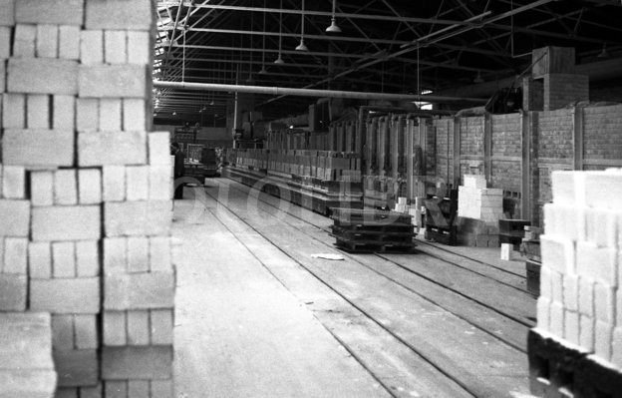
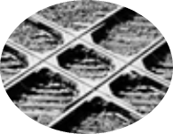
Turán's brick factory problem
Origin: Hungarian mathematician Pál Turán
How many crossings can there be in a complete bipartite graph?
K_{3,3}

Slide 6
Turán's brick factory problem
For K_{3,3}, 1
K_{3,3}

Slide 7
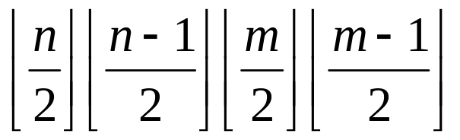
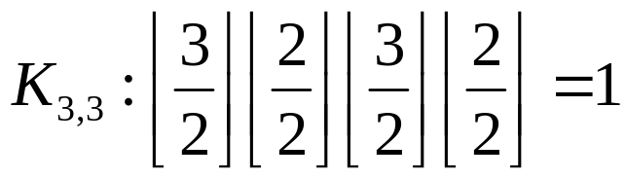
Turán's brick factory problem
Zarankiewicz’s conjecture
  For a complete bipartite graph K_{m,n}, at most
K_{3,3}

Slide 8
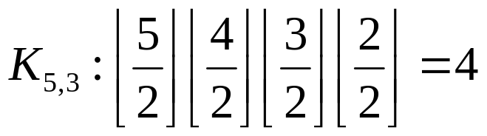
Turán's brick factory problem
What about K_{5,3}
See if you can get 4 crossing edges

Slide 9
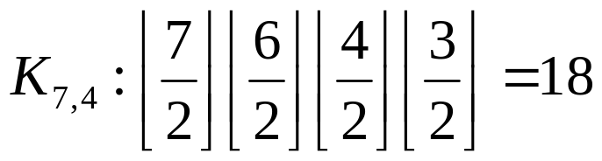
Turán's brick factory problem
Try K_{7,4}

Slide 10
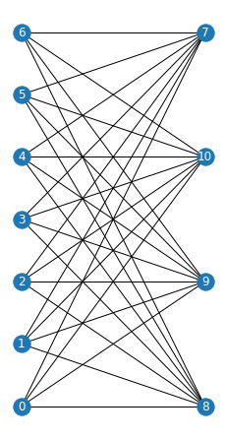
Graph layout
R allows many graph layouts
One of these is the bipartite layout
  Show K_{7,4} using the bipartite layout
import networkx as nx
import matplotlib.pyplot as plt
G = nx.complete_bipartite_graph(7, 4)
partition = nx.get_node_attributes(G, 'bipartite')
nodes = [i for i in partition.keys() if partition[i]==0]
nx.draw(G, pos=nx.bipartite_layout(G, nodes))
plt.show()

Slide 11
Other NetworkX layouts
bipartite_layout | Position nodes in two straight lines
circular_layout | Position nodes on a circle
kamada_kawai_layout | Position nodes using Kamada-Kawai path-length cost-function
planar_layout | Position nodes without edge intersections
random_layout | Position nodes uniformly at random in the unit square
shell_layout | Position nodes in concentric circles
spring_layout | Position nodes using Fruchterman-Reingold force-directed algorithm
spectral_layout | Position nodes using the eigenvectors of the graph Laplacian
spiral_layout | Position nodes in a spiral layout
multipartite_layout | Position nodes in layers of straight lines

Slide 12
Layered/hierarchical graph drawing
A directed graph can be represented as a “hierarchy”
  A cycle-free digraph (roughly)
  Process flow diagram
  Function call diagram
An example is the Sugiyama layout

Slide 13
Sugiyama layout
Follows the following principles as much as possible
  Edges should point in a uniform direction
  Short, straight edges
  Uniformly distributed nodes
  Minimize edge crossing

Slide 14
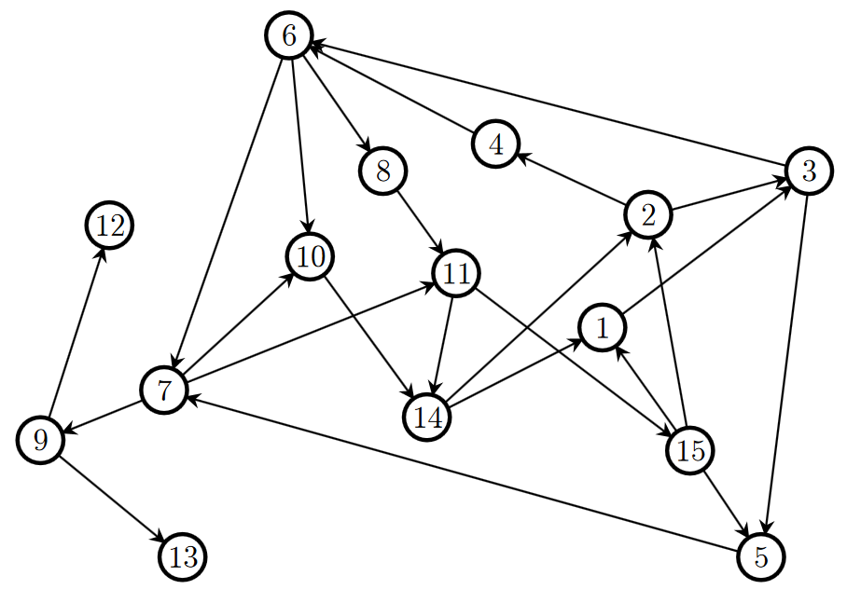
Sugiyama layout
Example: Convert the following graph to Sugiyama layout

Slide 15
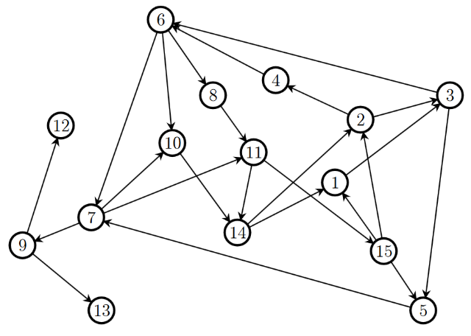
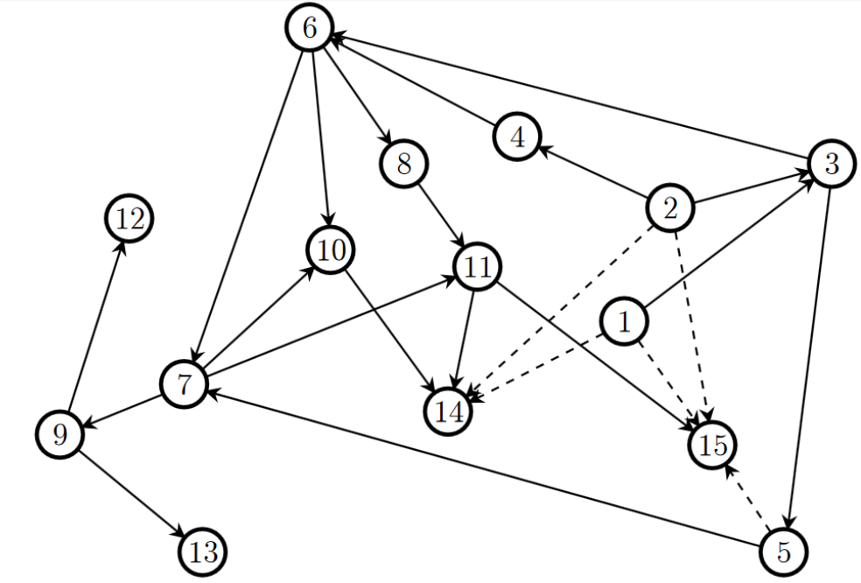
Sugiyama layout
1. Remove cycles
From “Handbook of Graph Drawing and Visualization”, Roberto Tamassia

Slide 16
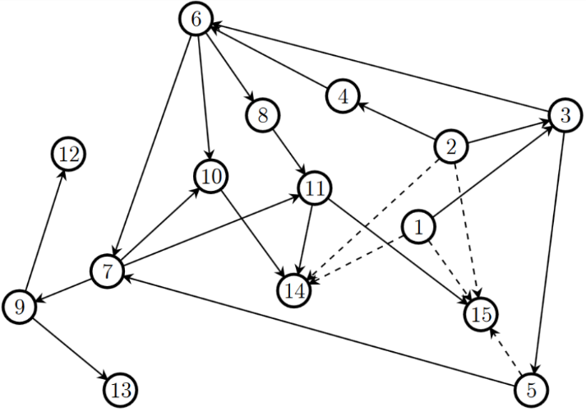
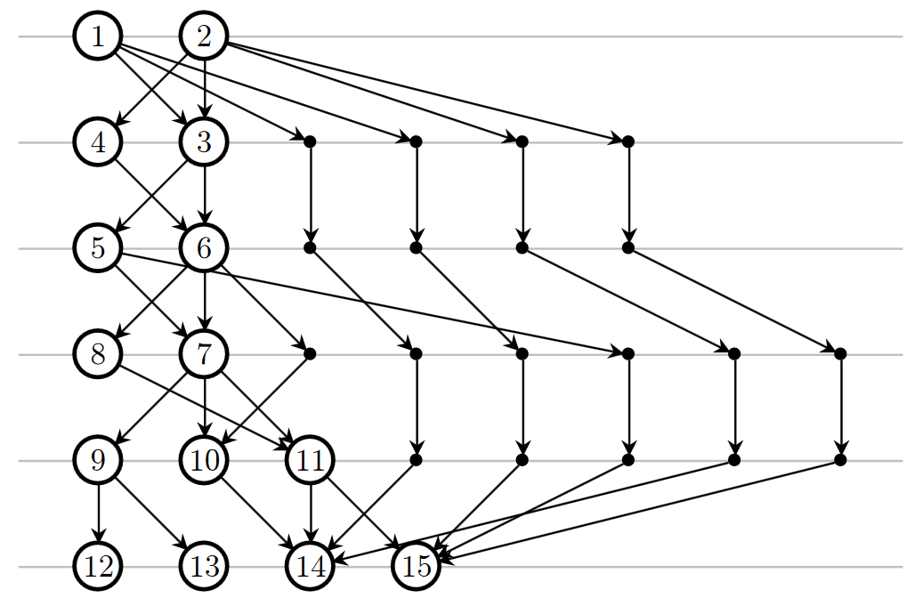
Sugiyama layout
2. Arrange nodes in levels
From “Handbook of Graph Drawing and Visualization”, Roberto Tamassia

Slide 17
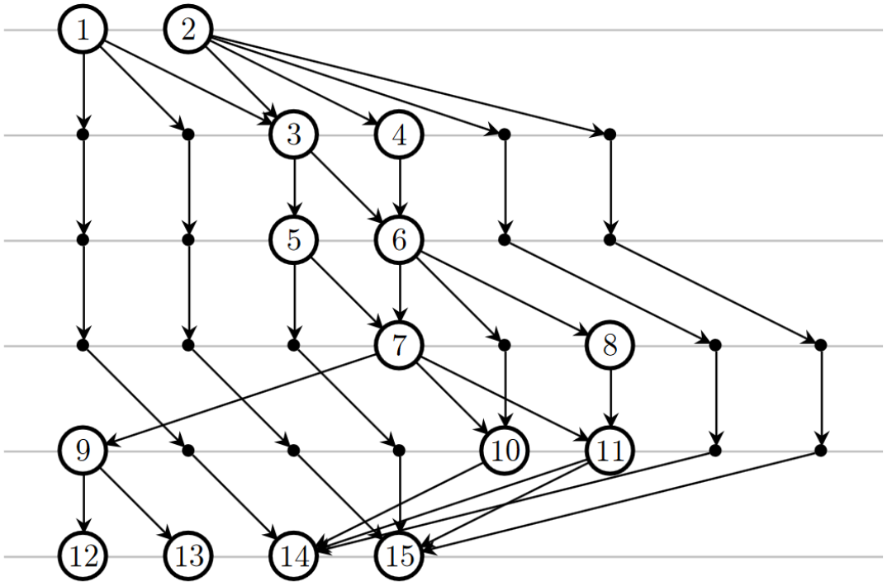
Sugiyama layout
3. Reduce crossing edges
From “Handbook of Graph Drawing and Visualization”, Roberto Tamassia

Slide 18

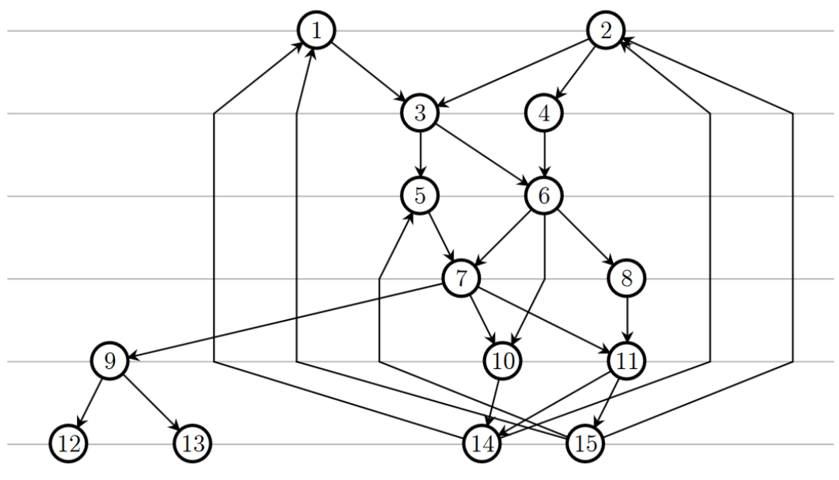
Sugiyama layout
4. Straighten edges
From “Handbook of Graph Drawing and Visualization”, Roberto Tamassia

Slide 19
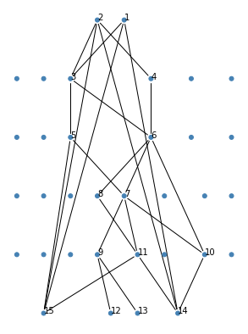
Sugiyama layout
How to do it in Python (igraph)
Regrettably this layout is not available in NetworkX
import igraph as ig
edges = [[x, y] for (x, y) in np.genfromtxt('sugiyama.csv', delimiter=',', dtype=np.integer)]
G = ig.Graph(edges=edges)
layers = [0, 0, 1, 1, 2, 2, 3, 3, 4, 4, 4, 5, 5, 5, 5]
layout = G.layout_sugiyama(layers=layers)
_, ax = plt.subplots()
ig.plot(G, layout=layout, vertex_label=list(range(1,16)), target=ax)
ax.invert_yaxis()

Slide 20
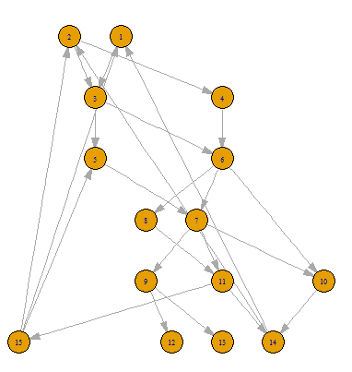
Sugiyama layout
How to do it in R (igraph)
# Construct graph
G <- graph_from_data_frame(sugiyama)
# Define layers
layers <- list(c(1, 2), c(4, 3), c(5,6), c(8,7), c(9,10,11), c(12,13,14,15))
# Perform layout
sugilayout <- layout_with_sugiyama(G, layers=apply(sapply(layers, function(x) V(G)$name %in% x), 1, which))
# Show Sugiyama plot
plot(G, layout=sugilayout$layout, vertex.label.cex=0.9, edge.arrow.size=0.1)
Same as the Python output

Slide 21
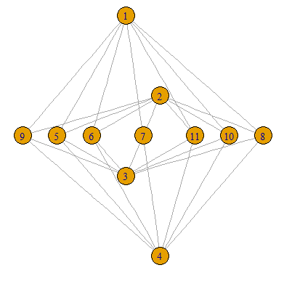
K_{7,4} revisited
Show K_{7,4} using Sugiyama layout (in R)
G <- graph_from_data_frame(K74, directed=FALSE)
layers <- list(c(1), c(), c(2), c(5,6,7,8,9,10,11), c(3), c(), c(4))
sugilayout <- layout_with_sugiyama(G, layers=apply(sapply(layers, function(x) V(G)$name %in% x), 1, which))
plot(G, layout=sugilayout$layout, vertex.label.cex=0.9)

Slide 22
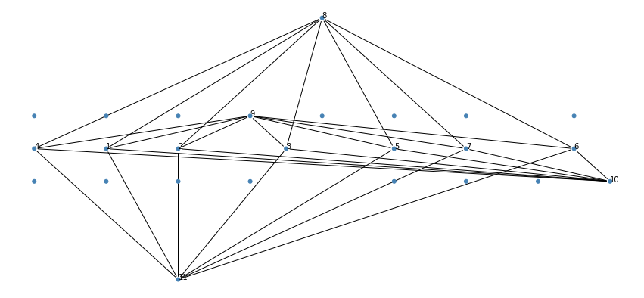

K_{7,4} revisited
Show K_{7,4} using Sugiyama layout (Python)
G = nx.complete_bipartite_graph(7, 4)
edges = list(G.edges)
G = ig.Graph(edges=edges)
layers = [4, 4, 4, 4, 4, 4, 4, 0, 3, 5, 8]
layout = G.layout_sugiyama(layers=layers)
_, ax = plt.subplots()
ig.plot(G, layout=layout, vertex_label=list(range(1,12)), target=ax)

Slide 23
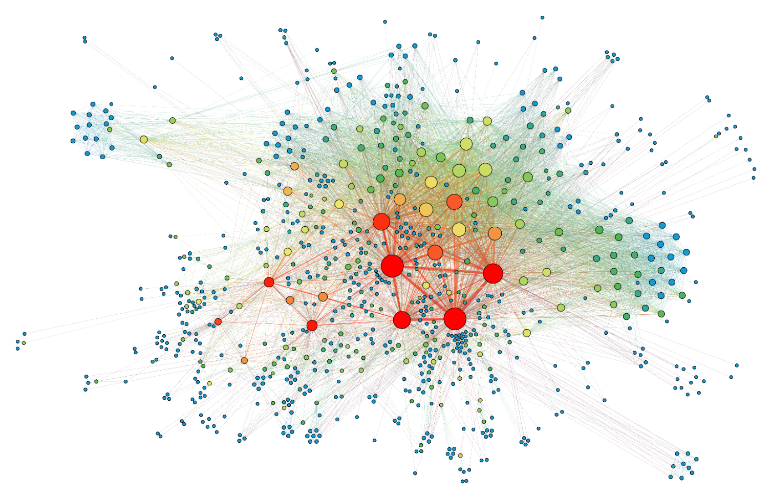
Force-directed graph layout
Commonly available, e.g nx.spring_layout
PalsGraph adds community information in applying the forces

Slide 24
Force-directed graph layout
PalsGraph implementation
  Each pair of vertexes i and j repel each other with a force F_{r}/d_{ij}
  Each pair of vertexes i and j that are connected by an edge attracts each other with a force F_{a}/d_{ij}
  (The centers of) two communities i and j repel each other with a force F_{rc}/d_{ij}
  (The centers of) each community c attracts every vertex v in community with force F_{ac}d_{cv}
  The center of the graph attracts vertices

Slide 25
Software for Visualization
Ng Yen Kaow

Slide 26
graphviz
A set of command-line tools
Grandfather of graph-drawing tools
File format (“dot”) widely supported
Used by other software
  Source codes visualization – doxygen
    https://www.doxygen.nl/
  Python modules, e.g. graph-tool
As a Python module
  https://github.com/pygraphviz/pygraphviz
dot | Plots hierarchical layouts of directed graphs
neato | Plots spring model layouts
twopi | Plots radial layouts
… and a few more

Slide 27
Python modules
Most popular modules are
  NetworkX (https://networkx.org/)
  igraph (http://igraph.org/)
    For R or Python or C
    Actually, mostly made for R until recently
  graph-tool (https://graph-tool.skewed.de/)
    For Python only
  Networkit (https://networkit.github.io/)
    For Python only
In general, graph-tool is the fastest and NetworkX is the slowest (pure Python)
  However, NetworkX is likely the most complete, well-documented, and easy to use

Slide 28
Gephi
GUI tool (but very powerful)
https://gephi.org/
File format (gexf) widely supported
Export graphviz file from Python
Allows vertices to be colored by their communities
  See “gephi_communities.pdf”
def export_edge_list(dismat, labels=None, filename="edges.csv", delim=",", header=True):
f = open(savedir + filename, 'w')
if header:
f.write("Source,Target\n")
loc = np.where(dismat > 0)
for (i, j) in [(i, j) for (i, j) in zip(loc[0], loc[1]) if i < j]:
if labels == None:
f.write(str(i) + delim + str(j) + "\n")
else:
f.write("\"" + labels[i] + "\"" + delim + "\"" + labels[j] + "\"\n")
f.close()

